Slide 1
Why IC (1-6)

Slide 2

The Enablers !
of the greatest art – work, that matters!

Slide 3

The biggest problem in communication is the illusion that it has happened (GBS)
Hello, Internal Communications !
Notes:
Simple. Importance of communication slide.

Slide 4
IC - In Plain English
Internal communication has a fundamental role to play to ensure that employees know what is going on and, at the same time, have a say about what important matters that is treated seriously.
The role of internal communications is much broader than just employer branding – ensuring that employees have a wider understanding of their organisation that includes vision, values, objectives, and performance. It has an information role of course, but really good internal communications is also about generating opportunities for employees to have a say in what the organisation does.
Notes:
Plain English meaning of IC. IC influences the right conversations that happen at the organization. We just need one of them. I have kept 3 to choose from. We can have completely different definition too. We want to encompass everything that IC can do.
Channels: are they working?
Content: are employees getting the information they want and need?
Conversations: are people communicating effectively?
Voice: are there adequate opportunities for people to have a say?
Sentiment: what do employees think and feel about the organisation?
Behaviour: has employee behaviour been influenced by communication?
So our idea is to bridge this gap between the management and the employees. Create opportunities for two way dialogue. A pleasing façade between the management and the employees with planned and systematic communication, that makes sense!

Slide 5
internal communication
What do we understand ?!
Employer Branding
Vision, Values, objectives and performance
Opportunities for employees
Notes:
(See in slideshow, its looking good- you can delete more words from this and keep some for your remembrance only )
Much broader than just employer branding
Ensures that employees have a wider understanding of their organisation that includes vision, values, objectives, and performance
Generates opportunities for employees to have a say in what the organisation does

Slide 6
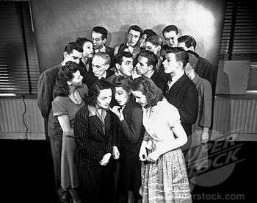
Conversations among the members of your marketplace(company) happen whether you like it or not.
Notes:
Conversations among the members of your marketplace(company) happen whether you like it or not. {Should we replace (Your) by (Our)}

Slide 7
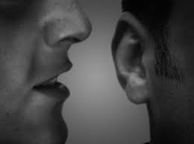
And less the people know,
more they yell!
Notes:
Hmm, there are various places for people to get to know about anything and everything happening at the workplace – about the company, about its direction (or direction), about its leaders, about its people, about its vision, about its reputation in the market, about almost everything !
If this information can come through an authentic source from the company, chances are better, or rather right, conversations will take place.
And if this information can come through the leader, it develops trust and a sense of belongingness !

Slide 8
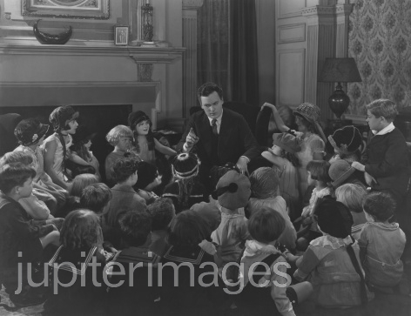
Good marketing encourages the right sort of conversations/IC influences the right conversations that happen at the organization
Notes:
Why do we say this- because “Good marketing” cannot be done by a singular department and right conversations cannot happen through isolation. We need your support because there is still so much trust or belief that RK can change the organisation. And your one step will help the employees to take 100 steps more towards your vision, because it’s a collective vision and not a stand alone one! And we want to help !

Slide 9

So, what are the conversations happening ?
Big picture context
Clarity of purpose
Company whereabouts
Am I needed?
What’s the future?
Where are we going ?
Them vs us
What is expected ?
How can I contribute ?
Am I adding value ?
No brand value
Notes:
See if we could convert all of the above in questions. But not more than 3 words. Possible ? Necessary ?
Our findings of the mini survey. But how do we bring the audience to this slide. How do we set the context.
As I go through the slides, I believe, the context is set. I think you can directly mention that you had spoken to people....
Manu: Company whereabouts- where are we going are same
Big picture context – whats the future are same
Clarity of purpose – How can I contribute and Am I adding value are same
See my change in Slide No 10

Slide 10
So, what are the conversations happening ?
Big picture context What’s the future? Am I adding value ?
Clarity of purpose How can I contribute ? What is expected ?
Company whereabouts Where are we going ?
Them vs us Am I needed?
Creating a brand value Can we collaboratively work towards it? / Can we collaborate ? (For 3 words)
Notes:
See if we could convert all of the above in questions. But not more than 3 words. Possible ? Necessary ? Yes, it sounds a good idea. So just retain these questions and when you present you can speak the purpose of this question.
Our findings of the mini survey. But how do we bring the audience to this slide. How do we set the context.
As I go through the slides, I believe, the context is set. I think you can directly mention that you had spoken to people....
Manu: Company whereabouts- where are we going are same
Big picture context – whats the future are same
Clarity of purpose – How can I contribute and Am I adding value are same
Also, Let us not write (NO) brand value- gives a negative connotation. Can we say – Creating a brand value

Slide 11
None of this can be fixed, though, unless there's communication
True communication.

Slide 12
1| Let’s get the Sumeru Dream Clear and through !
Our vision, mission, values and progress.
Notes:
<This will enhance employee engagement and thus all other goals that Sumeru has set>
Many people are starting to realize that they work a lot and that working on stuff they believe in (and making things happen) is much more satisfying than just getting a pay check and waiting to get fired (or die).
Collaboratively get the WHY of Sumeru clear
The vision-mission-goals statements
Publicize it through every possible manner –
Post it walls
Emails
All communication points
Get this reinforced through Big Picture meetings
Fist is : Bringing clarity to the purpose of Sumeru’s existence to employees. Collaboratively means – together, top management, we, every employee contributes. This exercise had happened before with Srini, Infosys X-CMO !! Lot of enthusiasm, everyone had participated, some findings, but nothing on the ground. Srini is an advisor to Sumeru now. So, how now IC will bring a change ! Tell :D
Living and breathing an authentic story is the best way to survive in a conversation-rich world. Building the sumeru story is essential.
Strategizing for consistent planned communication with the intended impact on this particular.

Slide 13
2| Let’s change the way we change !
Our change and new initiatives.
Notes:
When we surveyed, we realized the change communication that takes place at Sumeru does not make the required impact.
For e.g. Goal setting exercise. Most of the people did not know what was expected to be done. Many of them felt that it was too abrupt. It was disgraceful. Ultimately as a result, no “change” took place. And similar story goes for many such initiatives (Attendance tracking, leave policy etc).
As IC, we aim to change this. We would like to change the way any process is launched or any change initiative takes place at Sumeru.
If needed, we can call for personal meetings, we can stick posters, we can put screen savers and we can do all sorts of things to get the right things on top of the mind of people.
Ultimately, purpose of communication is “change”. :D
What's helpful is to realize that you have a choice when you communicate
Marketing campaigns with evocative ad hoc brand creations, seductive images, sensational metaphors, extraordinary testimonials, including the direct, warm, and personal participation of the firm’s leadership –
We will set the right tone, to make it more engaging.

Slide 14
3| Let’s get back to basics of communication !
Our way of emailing, conversing, everything.

Slide 15
Let’s make people fall in love with us !
Our internal branding.

Slide 16
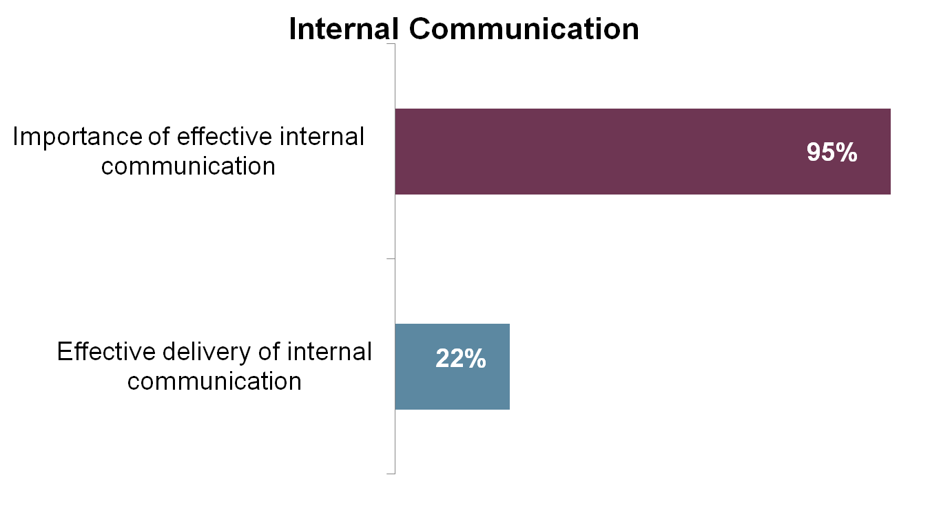
Gap: what leaders want vs. get
Deloitte & Touche Human Capital Survey of CEOs – which HR issues are important to the success of the business
Notes:
Now because of there is an illusion- the organization thinks that IC is existent, but is it delivered in the organization effectively? That is a question to ask !

Slide 17
Notes:
Here we can put that slide of vicious circle of how it affects employee engagement

Slide 18
What would we choose to do to engage people?
Give people a ten per cent pay rise
Take your team out to a special event
Tell people what is going on
Introduce a new suggestion scheme
Say “well done” for a good piece of work
Give people a say in what the organisation does
Give people a bonus day’s holiday if they take less
than 5 days off sick a year
Notes:
In bold is what is to be done.
In terms of employee engagement, there are three key factors:
1. Opportunities for upward feedback
2. Being well informed
3. Thinking that your manager is committed to the organisation
And all these are related to IC !!!!

Slide 19
What’s the link ! 7-10

Slide 20
So, what do we do

Slide 21

Unhappiness compounds.
Unaddressed, it compounds into frustration.
Notes:
And it spreads !

Slide 22
Solution : To address the unhappiness
Communicate – Connect – Change
Notes:
Definitely not the end of all problems! But we have to start! However abstract it may sound, this is important! Also when we are moving towards five important goals (which are also abstract) of
1) Client delight
2) Profitability
3) Employee morale
4) Process Compliance
5) Innovation
We need to communicate and enhance a two way communication. May not lead to increased productivity but will support less follow ups and timely delivery !

Slide 23
As we settle in
First things first ~
Notes:
We’re settling no, in the IC job. What can we do while we settling ?
The challenge of communication isn't to never miscommunicate, it's to cut down the time between the interaction and the realization that the communication didn't get through. Because the sooner we know we're not connecting, the sooner we can fix it.
Organizations that are good at flagging the misunderstood internal messages are far more likely to move quickly, in sync, than the ones that assume that messages from on high are never to be questioned. When in doubt, ask.

Slide 24
Continuous workshops on soft skill building
<Seths quotes on importance of soft skills>
Notes:
Improving ground level communication.

Slide 25
Hearing out ! And fixing ☺
Employee Engagement and IC – And picking up items as they come.
Notes:
(Have established the relation initially, so I don’t know if we need this)
Continuously hearing out employees through surveys and feedbacks.
Unhappiness compound.
Unaddressed, it compounds into frustration.
And frustration is the soul killer, the destroyer of worker and customer relationships, loyalty and progress.
The solution is pretty simple: address the unhappiness. Change the system or talk about the problem or acknowledge it if that's all that can be done. None of this can happen, though, unless there's communication.
Most open door policies are window dressing. Most, "is everything okay with your dinner?" is rote. True communication, actual intention (and action) in digging deeper, is difficult work. If it doesn't feel like you're working at it, you're probably not doing it right.

Slide 26
Small wins ! #Immediate
Smart dresscode
Softskill building trainings
Outbound
Employee Engagement and IC surveys and interviews
eNewsletter publishing
Formation of communication strategy with the top management for various department – the channel, tone, content help
Location change communication
Organization chart (VERY CLEAR)
Open communication enabling design at offices – more glass walls, less cabins, more
FAQs about sumeru to everyone
Dream board ! Compliments board ! Kerry sketches ! Coffee with CXOs ! Sumeru Story – book or video ! Random lunches ! Karaoke nights ! Quotation by G !
Artifacts and tools to engage better (WSRs are too boring. 15five is looking cool ;) )
Townhall meetings

Slide 27
Roles and skills
Adapted from Quirke (2008: 304-6)
Distributor and craftsman Select channels Write, design and event plan
Technical advisor
Use and manage technology Target audiences, channels and messages Work with feedback
Consultant and coach Facilitate thinking Prioritise and plan Co-ordinate Develop communication objectives from strategies Consult with clients
Extent
of
solution
Extent of need
Notes:
How do we want to contribute (You and me) to SS so that it grows ☺

Slide 28
Communication escalator
“There is a trade off to be made between the desire to be clear and the need to use communication media efficiently. The less chance of misunderstanding or misinterpretation, the leaner the media you can use.”
Awareness Newsletters
Understanding Roadshows Forums
Support Seminars Training
Degree of change
Commitment
Team problem solving
Involvement
Team meetings
Feedback forms
Degree of involvement
Quirke (2008: 158)
Notes:
Here, we need to add OUR initiatives, this is just for reference. Didn’t put them because have to get you buy in if this suits

Slide 29
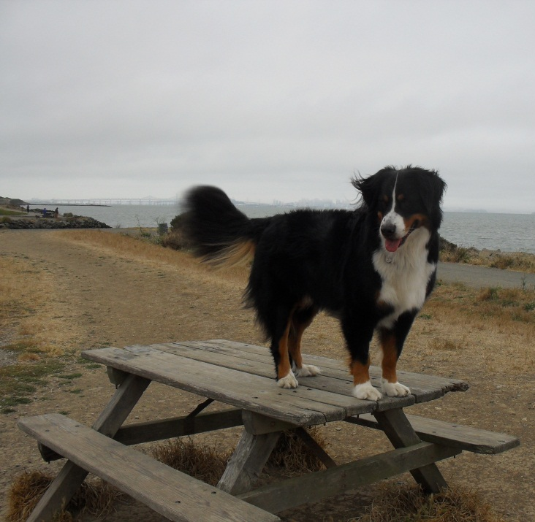
So what?
Get over the table!
Time and money is a barrier, yet …
We have to think leverage!
Value of:
Clarity of distance
Data that drives decisions
Impact of leaders

